Slide 1
Java for FTC 101
Session 2: Gamepad Controls and Decision Making

Slide 2
Overview
Recap Session 1, Finish any loose ends
Classes and Methods
Gamepad Controls
Building Your First Interactive Program
Sending Code to the Robot Controller
GitHub

Slide 3
Recap Session 1
Speed run time

Slide 4
Primitive data types
Category: Important
Type | Notes – Use them in this order
boolean | Can only be true or false. Used for flags and logic statements
int | Used for whole numbers (I.E. Ticks, bool math, indexing etc.)
double | Used for decimals, helpful but easy to overuse leading to problems.
void | Used when nothing is returned or stored, this is the same as having a “return returnAddress” which is what java will auto compiles this as.
Recap Session 1

Slide 5
(Other) Variables and Data Types
Category: Other… * Denotes Important
Type | Notes
String * | Represents a sequence of characters. Strings are immutable, meaning their values cannot be changed after creation.
Arrays * | Ordered collections of elements of the same type. Arrays can hold primitives or references.
Classes * | Blueprints for creating objects. Objects are instances of classes and encapsulate data (fields) and behavior (methods). – We’ll cover this in a different Session because they’re complicated and large.
Collections * We will touch on this way later. | Framework for storing and manipulating groups of objects, including: Lists: Ordered collections that allow duplicate elements (e.g., ArrayList, LinkedList). Sets: Collections that do not allow duplicate elements (e.g., HashSet, TreeSet). Maps: Collections that store key-value pairs (e.g., HashMap, TreeMap).
Recap Session 1

Slide 6
Inline Math
You can (And will) do math in line!
Math Operator | Meaning
= | Assignment Operator. int A = 1;
==, >, >=, <, <= | Comparison Operator. A == B, A >= B, etc.
+ | Addition Operator. int A = 1 + 1;
- | Subtraction Operator AND negative operator. int A = 1 - 1; int B = -5;
* | Multiplication Operator. int A = 5 * 5; //25
/ | Division operator - be aware that if you are using integers only the whole part is kept. It is NOT rounded. int A = (5 / 2); //2
Recap Session 1

Slide 7
Inline Math++
These are some more…
Math Operator | Example
++ | x++ means the same as x = x + 1
-- | x-- means the same as x = x - 1
+= | x += 2 means the same as x = x + 2
-= | x -= 2 means the same as x = x - 2
*= | x *= 2 means the same as x = x * 2
/= | x /= 2 means the same as x = x / 2
%= | x %= 2 means the same as x = x % 2
Recap Session 1

Slide 8
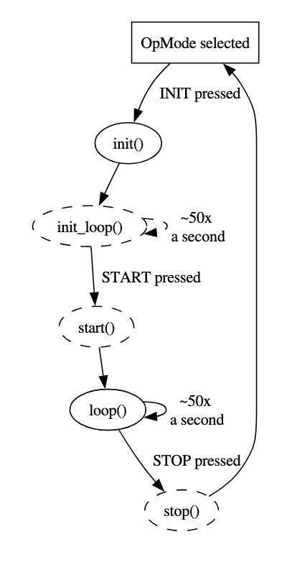
Understanding OpMode structure
Required Method | Function
init() | This is run once when the driver presses INIT.
loop() | This is run repeatedly (every 20 ms) after driver presses PLAY but before STOP.
Optional Method | Function
init_loop() | This is run repeatedly (every 20 ms) after driver presses INIT but before PLAY.
start() | This is run once when the driver presses PLAY.
stop() | This is run once when the driver presses STOP.
Recap Session 1

Slide 9
Start Downloading GitHub Desktop and Android Studio (with FTC SDK) now if not already done
Recap Session 1

Slide 10
Classes and Methods
This will feel backwards, I promise it’ll make sense eventually

Slide 11
Class members and instance variables
Defining the class:
A class is a model of something. It can contain data (members) and functions (methods).
Whenever you create a class, it becomes a data type that people can make variables of that type.
For example, the string data type is a class but we can have multiple objects of type string in our programs.
Remember that we name classes starting with a Capital letter and then every other word in the class name is also capitalized. (Pascal Case)
Class members and instance variables

Slide 12
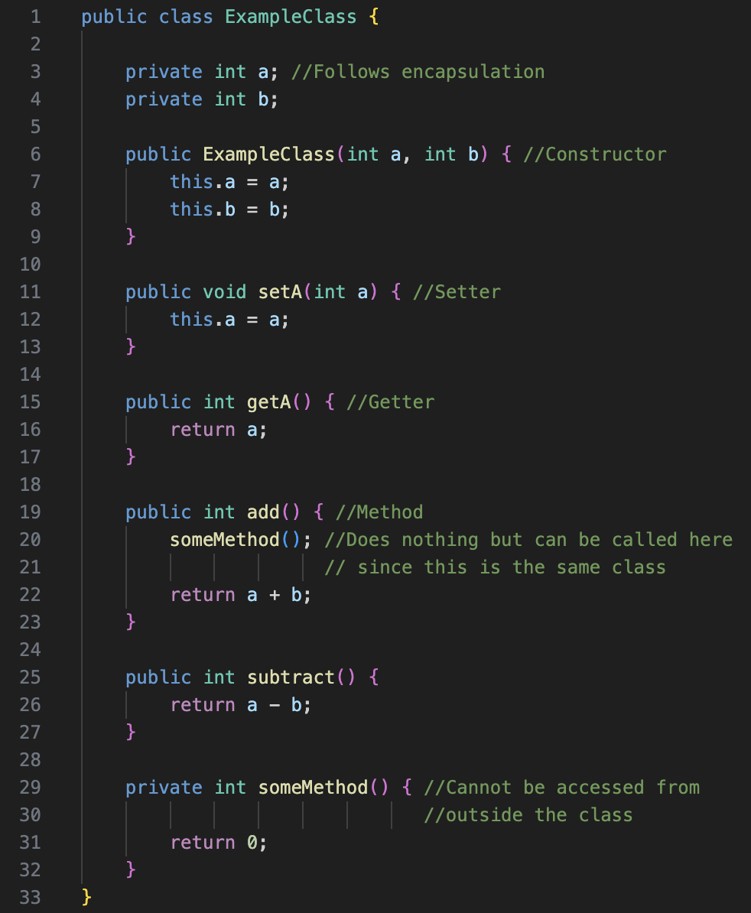
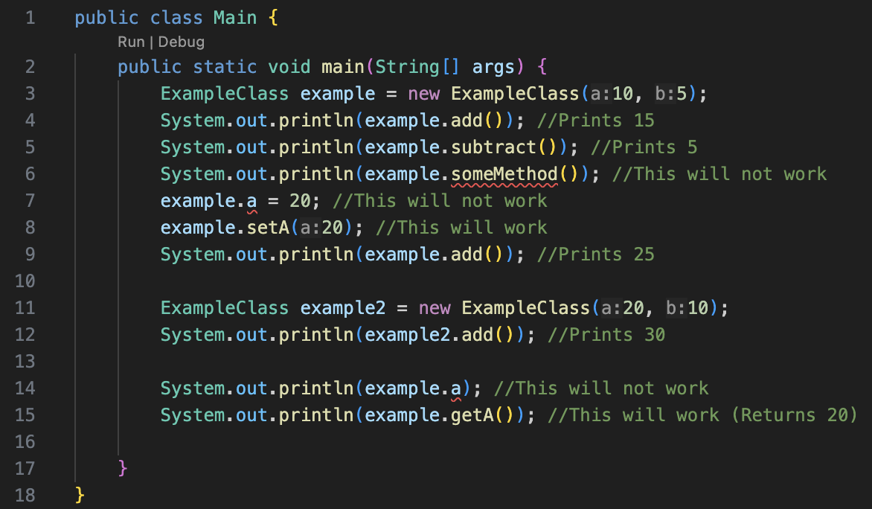
Example Class
See Example Class and an implementation for it!
Class members and instance variables

Slide 13
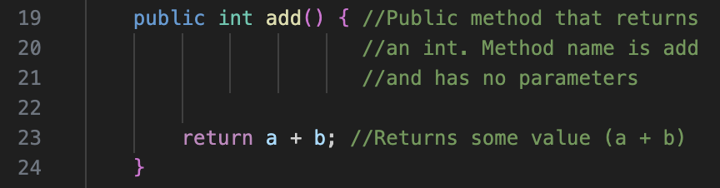
Defining a Method
Access Modifier
Method Name
Return type
Parameters
(There are none)
Defining a Method

Slide 14
Instance Variables
Laws of Encapsulation:
(Better than Coffee)
Declare instance variables as private: | This prevents direct access from outside the class, thus hiding the internal state of the object.
Provide public getter methods: | These methods, named get{VariableName}(), allow controlled read-only access to the private instance variables.
Provide public setter methods: | These methods, named set{VariableName}(), allow controlled modification of the private instance variables. They can include validation logic to ensure data integrity.
Consider making classes immutable: | If the object's state should not change after creation, avoid providing setter methods. This enhances security and simplifies concurrent programming. Use Final too!
Implement validation logic in setter methods: | Ensure that the data being assigned to the object's properties is valid and maintains the object's state consistency.
Follow the principle of least privilege: | An object should only have access to the information and resources necessary for its function strictly deny any access if not needed.
Use access modifiers appropriately: | ALWAYS use private, public, or protected access modifiers based on the required level of accessibility for class members.
Class members and instance variables

Slide 15
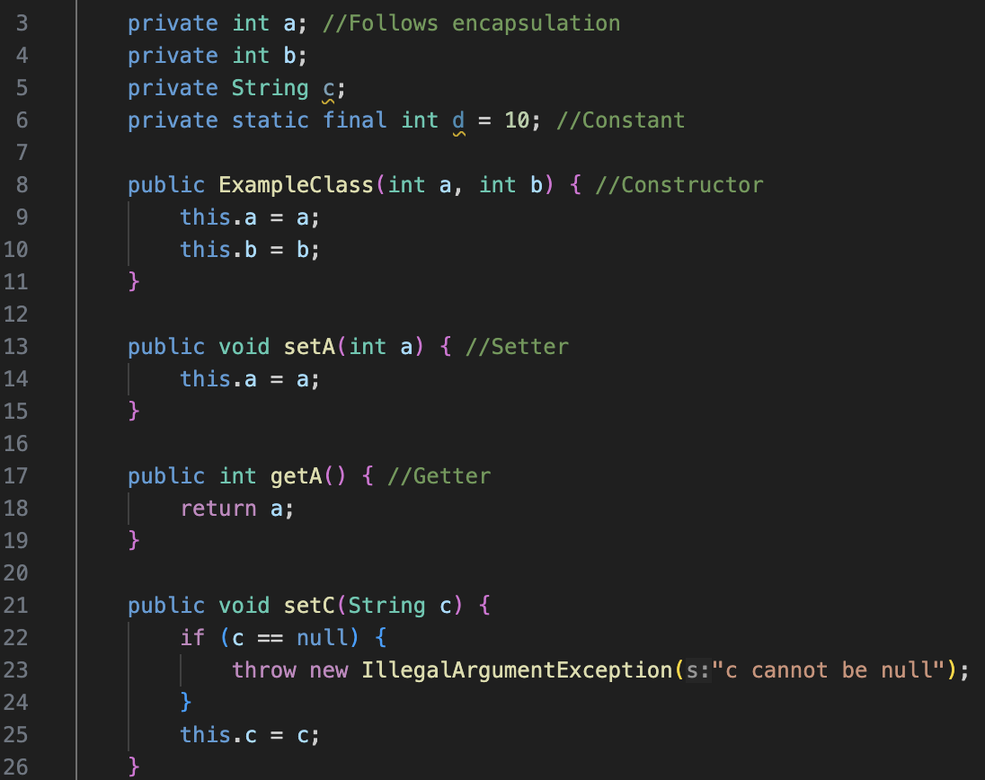
Instance Variables
Note that b should also have setters / getters
and c is missing a getter.
Example of a parameter!
Class members and instance variables

Slide 16
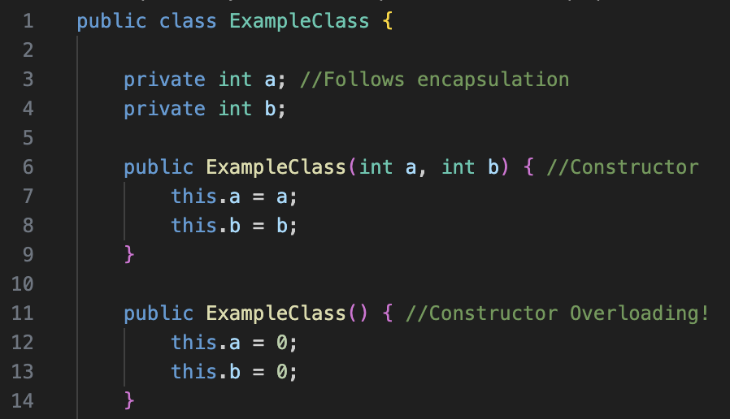
The Constructor
A constructor is a special method used to initialize objects of a class.
It must have the same name as the class and is invoked automatically when an object is created using the new keyword.
Constructors do not have a return type, not even void.
Their primary purpose is to set the initial state of an object by assigning values to its instance variables or performing other setup tasks.
A class can have multiple constructors with different parameter lists (Constructor Overloading), allowing objects to be initialized in various ways. You only use one constructor but any are allowed. They cannot use the same parameter types in the same order
(See bad overload on next slide)
Class members and instance variables

Slide 17
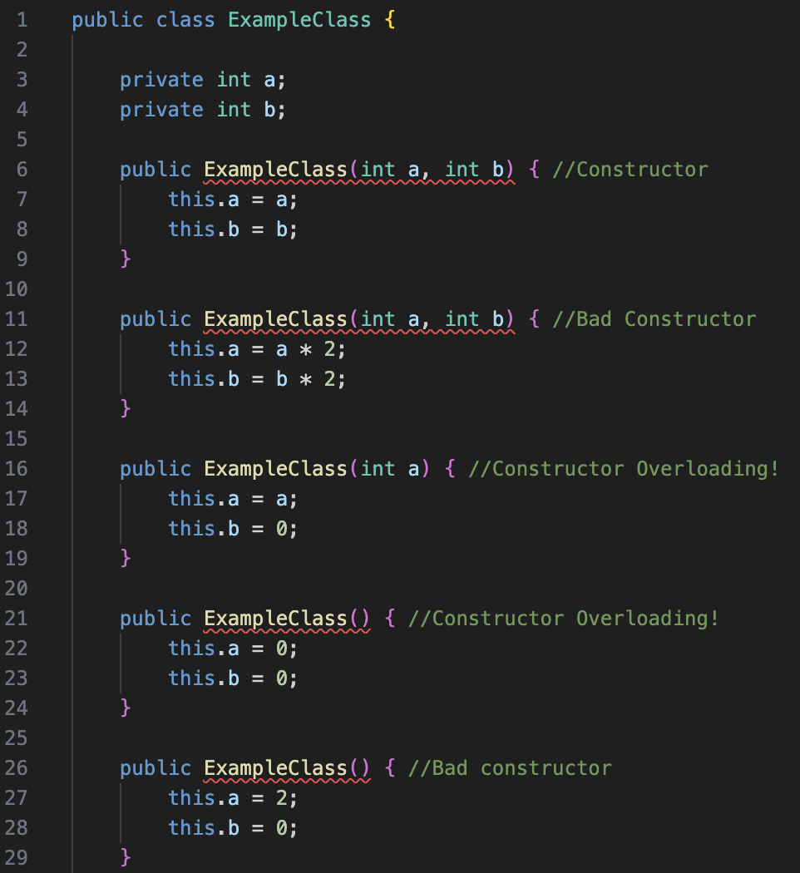
The Constructor
A class can have multiple constructors with different parameter lists (Constructor Overloading), allowing objects to be initialized in various ways. You only use one constructor but any are allowed. They cannot use the same parameter types in the same order
Class members and instance variables

Slide 18
Example Class – Any Questions??
See Example Class and an implementation for it!
Class members and instance variables

Slide 19
Gamepad Controls

Slide 20
The Gamepad
Since there are two of them, they are called gamepad1 and gamepad2.
The buttons on the gamepad are all boolean (true if they are pressed, false if they aren’t).
The d-pad is exposed as four buttons.
The joysticks are double with values between -1.0 and 1.0 (0.0 means in the center). There is one for each x (side to side) and one for each y (up and down).
The left trigger and right trigger are also double with values between 0.0 and 1.0 (0.0 means not pressed, 1.0 means fully pressed).
Gamepad Controls

Slide 21
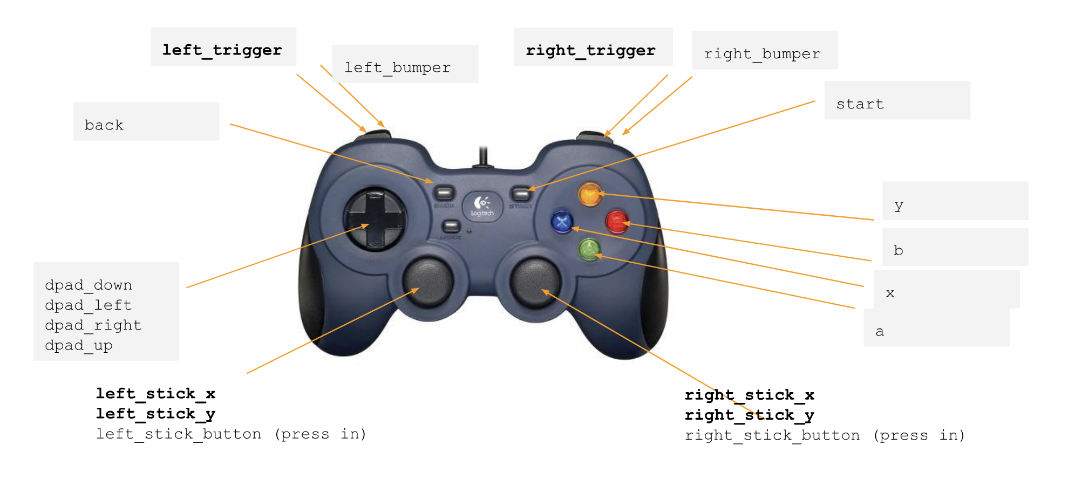
The Gamepad
*Bold is double
The rest are booleans
Gamepad Controls

Slide 22
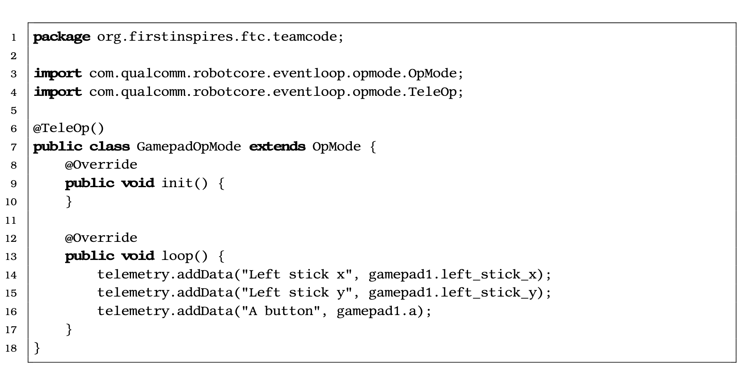
Reading analog inputs
Double
Boolean
Gamepad Controls

Slide 23
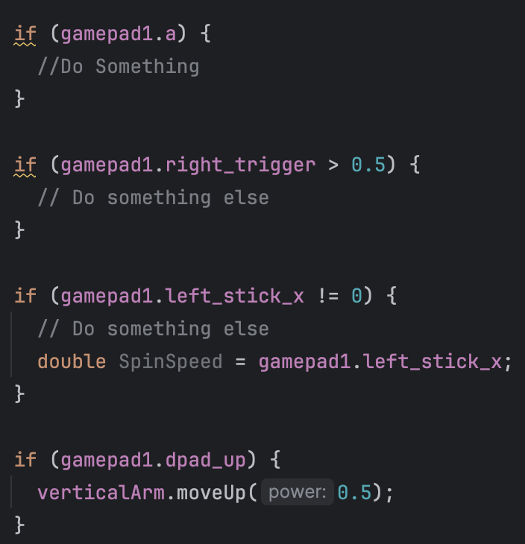
Reading Inputs
This is what it might look like in the robot container loop!
Gamepad Controls

Slide 24
Building Your FIRST ® Interactive Program
*Fight for Me Opening Moment*
(Waters, Daniel. Heathers : The Musical. Samuel French, 2015.)

Slide 25
Creating a gamepad test program
Can you do the following?
Add telemetry to show the right stick of gamepad1.
Add telemetry to show whether the b button is pressed on gamepad1.
Report to the user the difference between the left joystick y and the right joystick y on gamepad1.
Report to the user the sum of the left and right triggers on gamepad1.
Building Your First Interactive Program

Slide 26
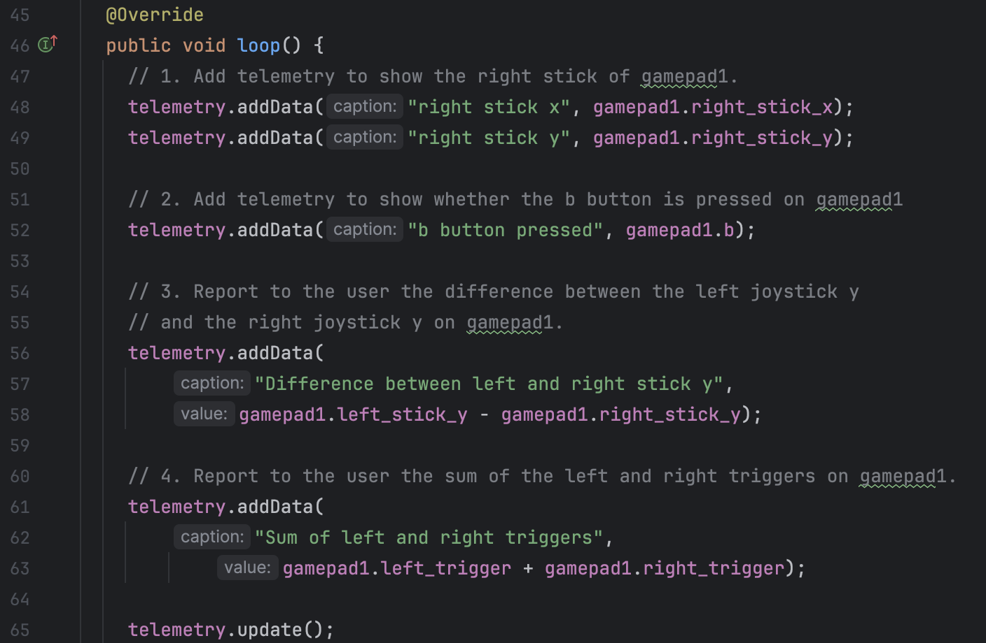
(Answers) Creating a gamepad test program
Building Your First Interactive Program

Slide 27
Sending (your) Code to the Robot Controller

Slide 28
Creating a gamepad test program
Turn on and connect to the robot.
Then go to http://192.168.43.1:8080
Go to OnBotJava and upload your new file.
Build it.
Go to the robot controller and select your program.
Init, Enable, and test!
Building Your First Interactive Program

Slide 29
GitHub
Git good or git out

Slide 30
Git and GitHub
Git is the system that takes care of your project history, GitHub is one of many online repository hosting platforms utilizing Git. Everyone uses GitHub, if you know GitHub you are set.
GitHub is to Git what Steam is for your PC games.
GitHub is to Git what Spotify is for your Songs.
GitHub is to Git what Messenger is for your texting apps.
GitHub is to Git what YouTube is for videos.
GitHub is to Git what Gmail is for your emails.
GitHub is to Git what Google Drive is for your documents.
GitHub is to Git what Finder is for your files.
My dad uses Bitbucket 🤮
Get the idea yet?
GitHub

Slide 31
Creating a Repo (Demonstration)
Make one for your program :)
GitHub

Slide 32
Making Branches, PR’s, Commits, Pulls/Pushes
Demonstration but you can do too
GitHub

Slide 33
Good Commits / Comments
Demonstration but you can do too
GitHub

